Slide 1
Project Management
Critical Path Method (CPM)

Slide 2
ES – Earliest Start
EF – Earliest Finish
LS – Latest Start
LF – Latest Finish
t – Time
EF = t + ES
LS = LF – t

Slide 3
Activity Name
t | ES | EF
 | LS | LF

Slide 4
Forward Movement – Maximum number of days
Backward Movement – Minimum number of days
Slack: how long an activity can be delayed without extending the finish time.
Slack = LS – ES / LF – EF
Slack = 0 -> Critical Activity

Slide 5
QUESTION:
 | A | B | C | D | E | F | G
P | - | - | A | A,B | D | C,E | E
t | 7 | 9 | 12 | 8 | 9 | 6 | 5

Slide 6
A
C
F
B
D
E
G

Slide 7

SOLUTION:
A
7 | 0 | 7
 | 2 | 9
C
12 | 7 | 19
 | 14 | 26
Slack = 2
Slack = 7
B
9 | 0 | 9
 | 0 | 9
D
8 | 9 | 17
 | 9 | 17
Slack = 0
Slack = 0

Slide 8
F
6 | 26 | 32
 | 26 | 32
G
5 | 26 | 31
 | 27 | 32
Slack = 0
E
9 | 17 | 26
 | 17 | 26
Slack = 1
Slack = 0

Slide 9
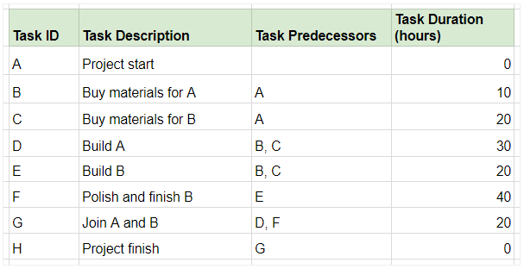

Slide 10
Important Note
Start listening to the narration from slide 8.
Move in the backward manner that is slide 8 first and 7 after it.
Once you are done with the narration solve the problem in slide 9.
If you still have any issue please feel free to contact me on ridah.fatima@iuk.edu.pk

